Slide 1
IoT Abhiyaan
Rajasthan IT Day 2018 – Hackathon 4.0
March 21st, 2018

Slide 2
One minute concept slide
Only for someone with limited time!

Slide 3
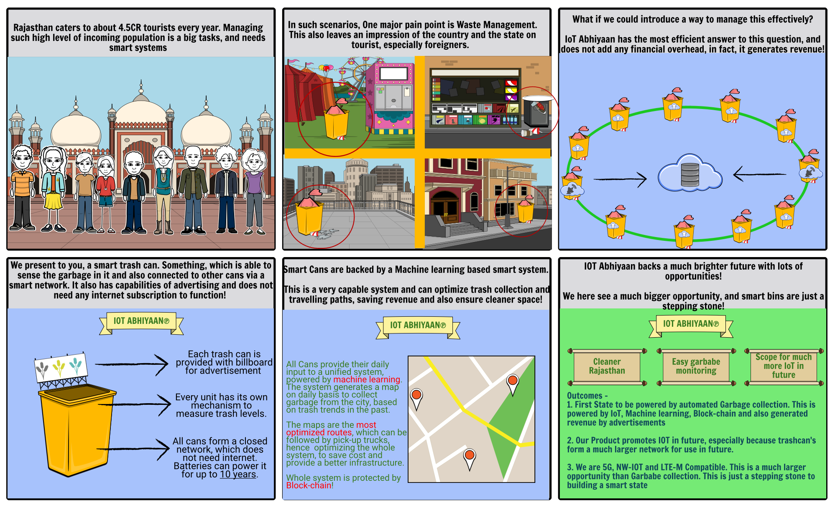

Slide 4
Agenda:
Quick Facts
Our Solution
Overall Enhancement
Optimization and Initiatives
Product status
Video Link - https://ant.umn.edu/ddhdevdkwq/view
Your team:
Basuraj Agrawal
Shivam Singh
Prannoy Dhakkad

Slide 5
Fact based evident analysis
Defining the greater problem, for the entire country!

Slide 6
Only 68% of the garbage generated in the country is collected, of which 28% is treated by the municipal authorities. Thus, the poor collection and treatment of waste leads to dumped garbage on streets clearly showing up the poor and inefficient system available to tackle waste management in urban areas.
Central Pollution Control Board

Slide 7
If this issue is not tackled efficiently and better policies and practices for waste management are not adopted, the total waste generation is projected to be 165 million tonnes by 2031 and 436 million tones by 2050.
That’s exactly 7 times the waste generated today!
Central Pollution Control Board

Slide 8
On the contrary,

Slide 9
India has spent close to 25,000 crore on the Swachh Bharat (Clean India) Mission in the last two years.
Right to Information

Slide 10
So, What did we miss?

Slide 11
The answer simply lies with
“The 5.4 Million Truckloads* Daily”
India’s Real Trash Management Problem
*Roughly 80 million tons of garbage everyday!

Slide 12
Our Solution (what we did)
The most technical, analytical and comprehensive approach to this problem

Slide 13
Solution Specification
Interconnected dustbin implementation, without the use of internet.
Each dustbin has sensors and communication devices which last for 10 years easily on a small battery.
Each device is able to communicate with one another up to 10 Kms.
Use of data sciences (machine learning) to optimize waste collection.
Outcomes
At least 40% reduction in costs for collecting waste. No more issues of overflowing bins. Easy transportation for drivers. At least 25% reduction in pollution emissions across the city (both stats are based on white papers).
The city forms a back-up network, which can be further used for smart lighting, parking or any future smart city’s implementation. This serves as a ‘smart cities network’ to any city it is implemented in.

Slide 14
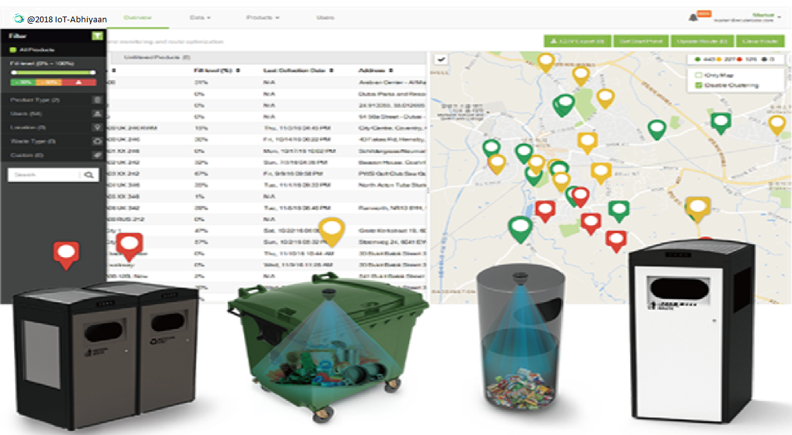
ONE SHOT STORY TO OUR SYSTEM!
Our Dustbins are smart!
Each of our dustbins will have a Smart capacity sensor. They talk to each other in a network and update central system with their capacity every 5 minutes! (live demo available right now!)
Our Console helps you track!
The console is a Artificially Intelligent
Portal which shows you garbage across
All dust-bins in city/area/pincode level.
It also forms a list of bins which requires
Immediate garbage collection!
We generate most optimized
Garbage collection Map!
The system also can generated the Most optimized map for you to go ahead And collect your garbage. This means You now only save money by selective arbage bin collection, but also because Of travelling lesser to collect data (live demo available right now!)
It gets smarter everyday!
We save the data generated by bins are
Saved and used to train machine learning
Models. We are currently using it with
Markov’s chain and BG-NBD to optimize
Workforce and prefect bin full time

Slide 15




WASTE ANALYTICS PLATFORM
Predictive analysis
As data is collected, our ML algorithm will intelligently learn from your waste generation patterns to allow you to see your status up to 24 hours into the future. This allows you to optimize your collection routes and generate more efficient routes as opposed to using real-time data.
Universally accessible
IoT-Abhiyaan is a cloud-based service and can be accessed from any device with an internet browser. Optimized for desktop, mobile, and tablet devices, IoT-Abhiyaan is accessible anywhere anytime. No special software is required, no downloads or installations, simply log in and you’re up and running.
Actionable insight
Collection performance and efficiency, overflow frequency, waste generation, sub-optimal collections, and more comprehensive reports are available to help you understand your operations and pinpoint areas that can be improved.
Monitor your entire waste management operation
Using IoT-Abhiyaan, you can keep a track of all your bins, monitor fill levels and fill level history, optimize collection routes, check battery levels, geographical locations, collection history, overflow status, response times, fire events, and more.

Slide 16
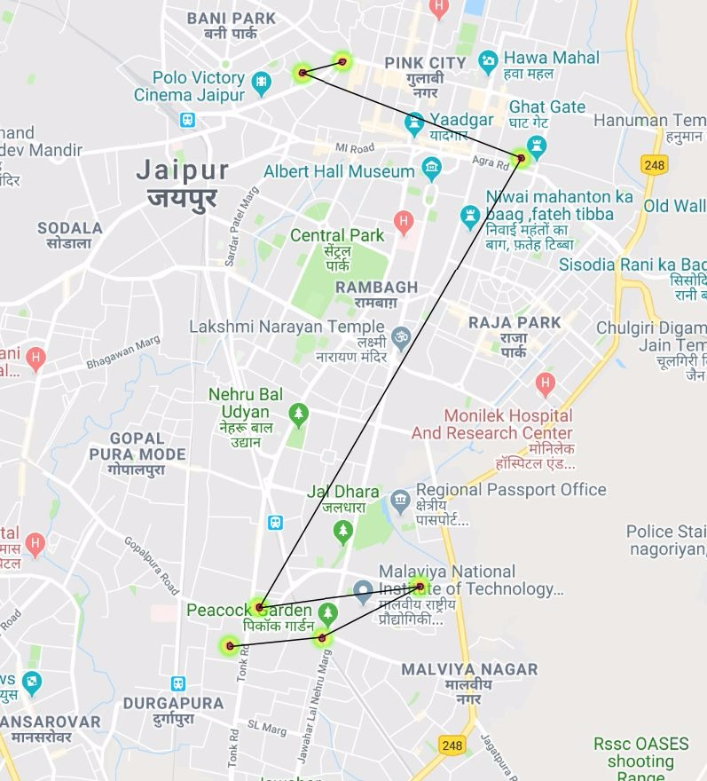
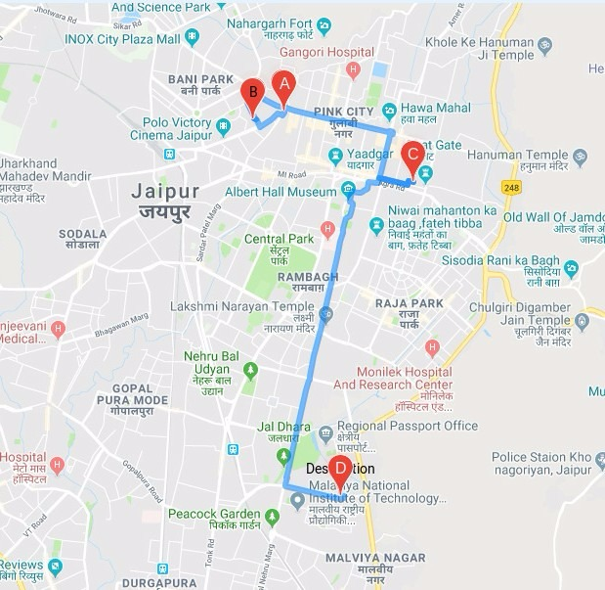
OPTIMISING PICKUP SCHEDULES
The system generates a map on a daily basis to collect garbage from the city, based on trash trends from the past. (We have this live on oms.iot-abhiyaan.com/map – on phone)

Slide 17
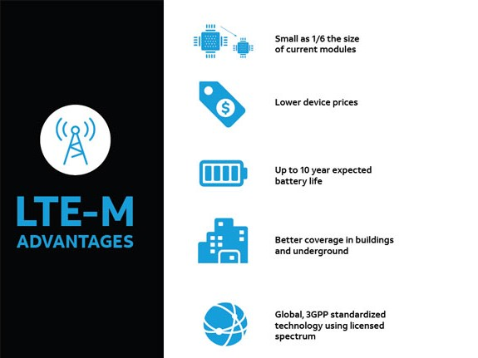
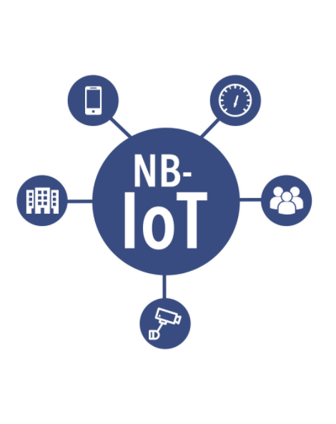
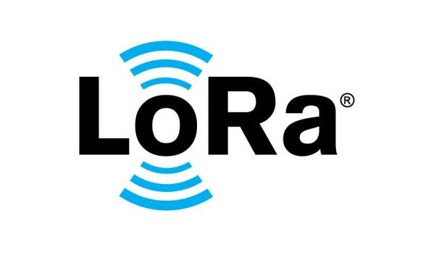
Technologies
As part of our drive towards low power networks, some of the tech utilized here is are very new and secure. In fact, We are the one of the first to implement a smart cities using NB-IOT in India.

Slide 18
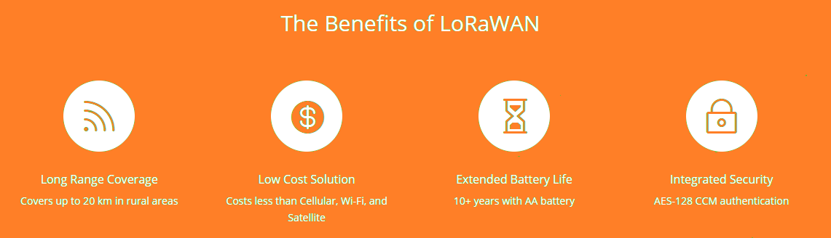
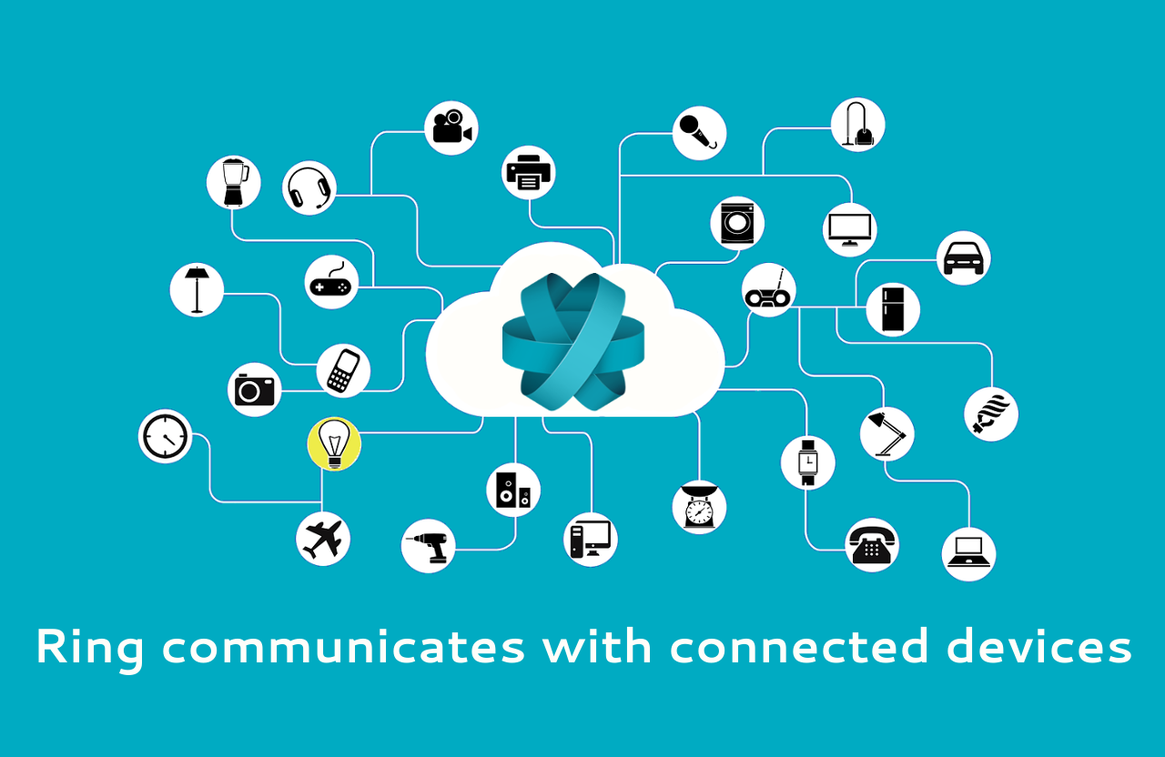
Now what if we could leverage the power of our network to connect devices ensuring –
1. Connectivity over a large distance
2. Without any power issues
3. Generating revenue by advertising as well!

Slide 19
Given the power of the Internet of Things, number of connected devices will be 30.7 billion in 2020, and grow to 75.4 billion by 2025.
IHS Markit

Slide 20

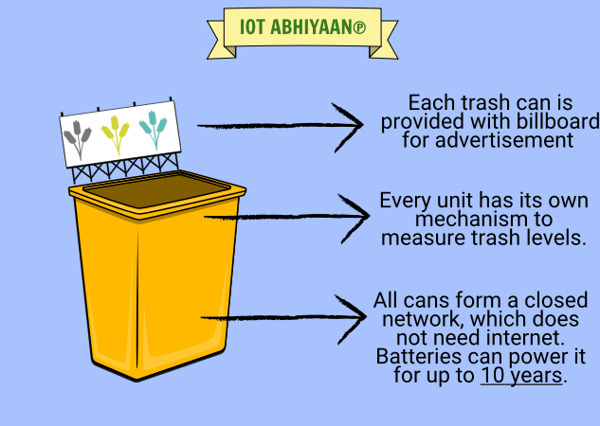
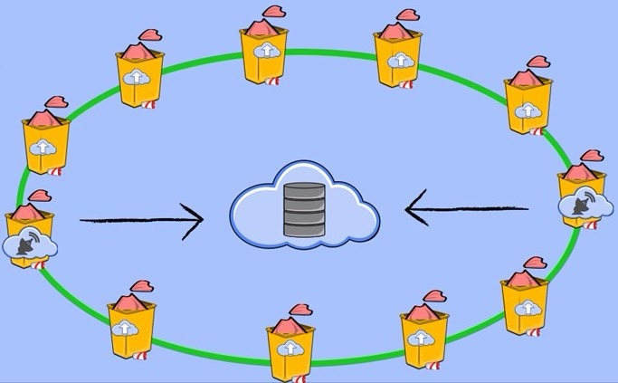
FROM CANS TO SMART CANS

